Slide 1
Chapter 32
Inductance

Slide 2
Inductance
Self-inductance
  A time-varying current in a circuit produces an induced emf opposing the emf that initially set up the time-varying current.
    Basis of the electrical circuit element called an inductor
  Energy is stored in the magnetic field of an inductor.
  There is an energy density associated with the magnetic field.
Mutual induction
  An emf is induced in a coil as a result of a changing magnetic flux produced by a second coil.
Circuits may contain inductors as well as resistors and capacitors.
Introduction
Notes:
In Chapter 31, we saw that an emf and a current are induced in a loop of wire when the magnetic flux through the area enclosed by the loop changes with time.

Slide 3
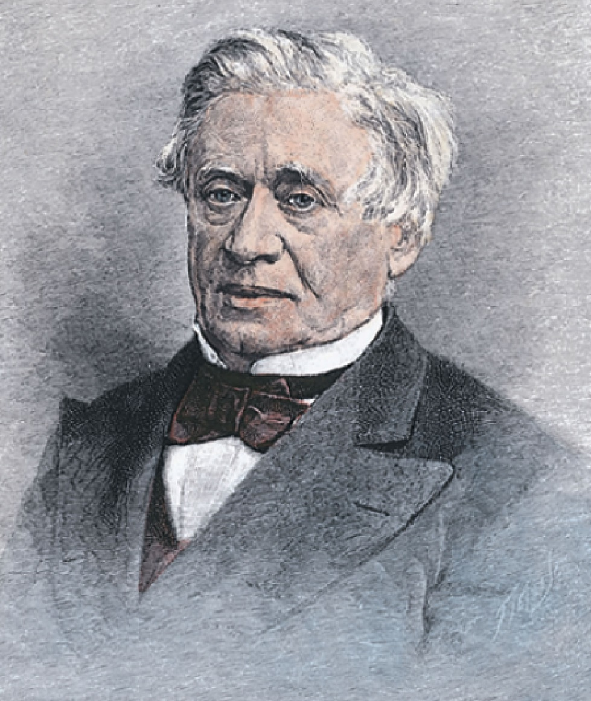
Joseph Henry
1797 – 1878
American physicist
First director of the Smithsonian
First president of the Academy of Natural Science
Improved design of electromagnet
Constructed one of the first motors
Discovered self-inductance
  Didn’t publish his results
Unit of inductance is named in his honor
Section 32.1

Slide 4
Some Terminology
Use emf and current when they are caused by batteries or other sources.
Use induced emf and induced current when they are caused by changing magnetic fields.
When dealing with problems in electromagnetism, it is important to distinguish between the two situations.
Section 32.1

Slide 5
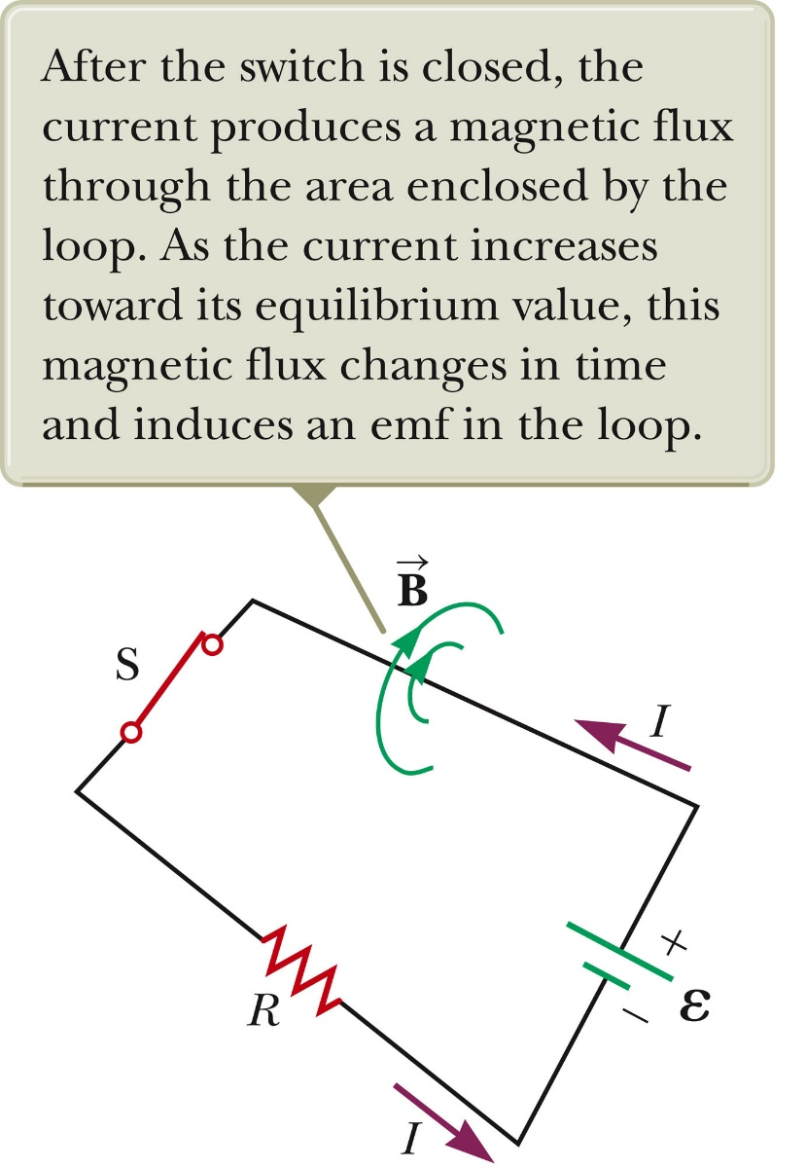
Self-Inductance
When the switch is closed, the current does not immediately reach its maximum value.
Faraday’s law of electromagnetic induction can be used to describe the effect.
As the current increases with time, the magnetic flux through the circuit loop due to this current also increases with time.
This increasing flux creates an induced emf in the circuit.
Section 32.1

Slide 6
Self-Inductance, cont.
The direction of the induced emf is such that it would cause an induced current in the loop which would establish a magnetic field opposing the change in the original magnetic field.
The direction of the induced emf is opposite the direction of the emf of the battery.
This results in a gradual rather than instanteonous increase in the current to its final equilibrium value.
This effect is called self-inductance.
  Because the changing flux through the circuit and the resultant induced emf arise from the circuit itself.
The emf ε_{L} is called a self-induced emf.
Section 32.1

Slide 7
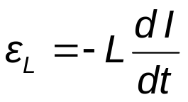
Self-Inductance, Equations
An induced emf is always proportional to the time rate of change of the current.
  The emf is proportional to the flux, which is proportional to the field and the field is proportional to the current.
L is a constant of proportionality called the inductance of the coil.
  It depends on the geometry of the coil and other physical characteristics.
Section 32.1
Notes:
To obtain a quantitative description of self-induction, recall from Faraday’s law
that the induced emf is equal to the negative of the time rate of change of the magnetic
flux.

Slide 8

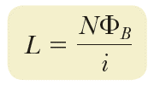
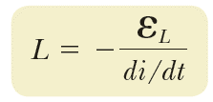
Inductance of a Coil
A closely spaced coil of N turns carrying current I has an inductance emf of
Which leads to an inductance of
The inductance is a measure of the opposition to a change in current.
The resistance is a measure of the opposition to current.
Section 32.1
Notes:
Combine the first equation with the equation in the previous slide to get the expression for L

Slide 9
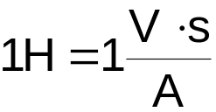
Inductance Units
The SI unit of inductance is the henry (H)
Named for Joseph Henry
Section 32.1

Slide 10
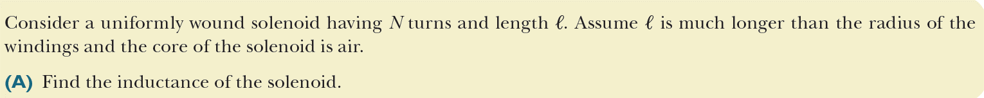
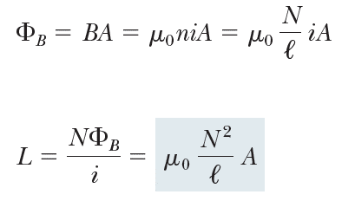


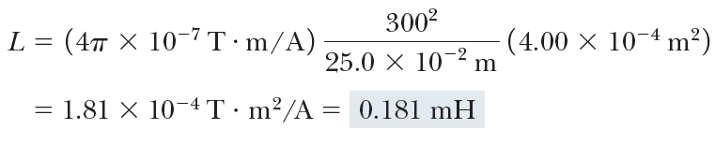
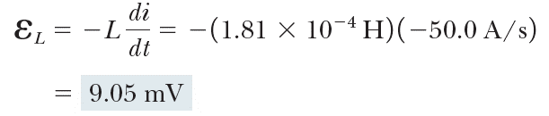
Inductance of a Solenoid, Example
Or by using
Section 32.1

Slide 11

RL Circuit, Introduction
A circuit element that has a large self-inductance is called an inductor.
The circuit symbol is
We assume the self-inductance of the rest of the circuit is negligible compared to the inductor.
  However, even without a coil, a circuit will have some self-inductance.
Section 32.2

Slide 12
Effect of an Inductor in a Circuit
The inductance results in a back emf.
Therefore, the inductor in a circuit opposes changes in current in that circuit.
  The inductor attempts to keep the current the same way it was before the change occurred.
  The inductor can cause the circuit to be “sluggish” as it reacts to changes in the voltage.
Section 32.2
Notes:
Sluggish: slow-moving or inactive.
If the battery voltage in
the circuit is increased so that the current rises, the inductor opposes this change
and the rise is not instantaneous. If the battery voltage is decreased, the inductor
causes a slow drop in the current rather than an immediate drop. Therefore, the
inductor causes the circuit to be “sluggish” as it reacts to changes in the voltage.

Slide 13
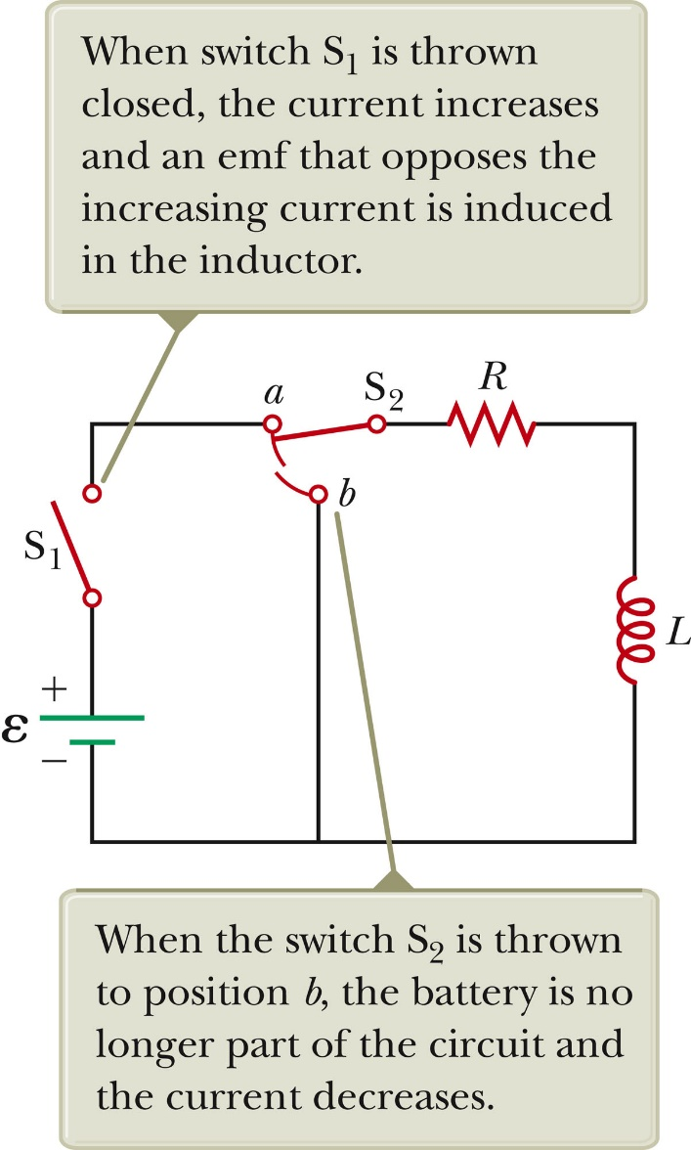
RL Circuit, Analysis
An RL circuit contains an inductor and a resistor.
Assume S₂ is connected to a
When switch S₁ is closed (at time t = 0), the current begins to increase.
At the same time, a back emf is induced in the inductor that opposes the original increasing current.
Section 32.2

Slide 14


RL Circuit, Analysis, cont.
Applying Kirchhoff’s loop rule to the previous circuit in the clockwise direction gives
Looking at the current, we find
Section 32.2

Slide 15
RL Circuit, Analysis, Final
The inductor affects the current exponentially.
The current does not instantly increase to its final equilibrium value.
If there is no inductor, the exponential term goes to zero and the current would instantaneously reach its maximum value as expected.
Section 32.2

Slide 16


RL Circuit, Time Constant
The expression for the current can also be expressed in terms of the time constant, τ, of the circuit.
  where τ = L / R
Physically, τ is the time required for the current to reach 63.2% of its maximum value .
Section 32.2

Slide 17
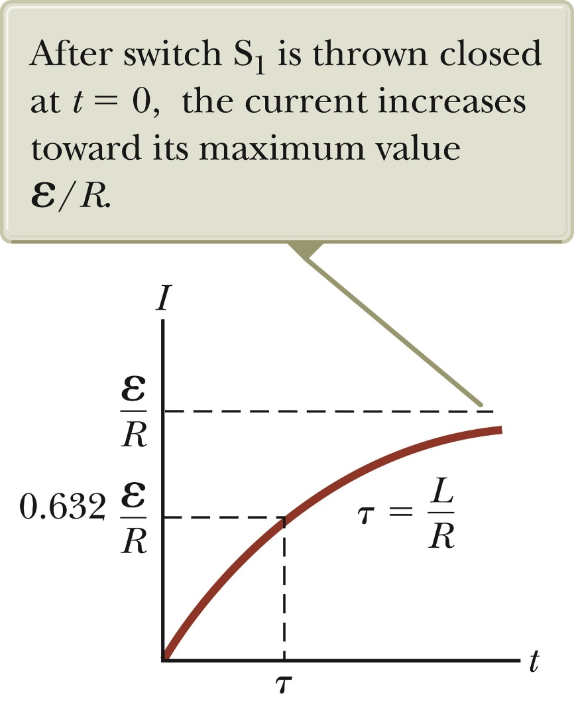
RL Circuit, Current-Time Graph, Charging
The equilibrium value of the current is ε /R and is reached as t approaches infinity.
The current initially increases very rapidly.
The current then gradually approaches the equilibrium value.
Section 32.2

Slide 18
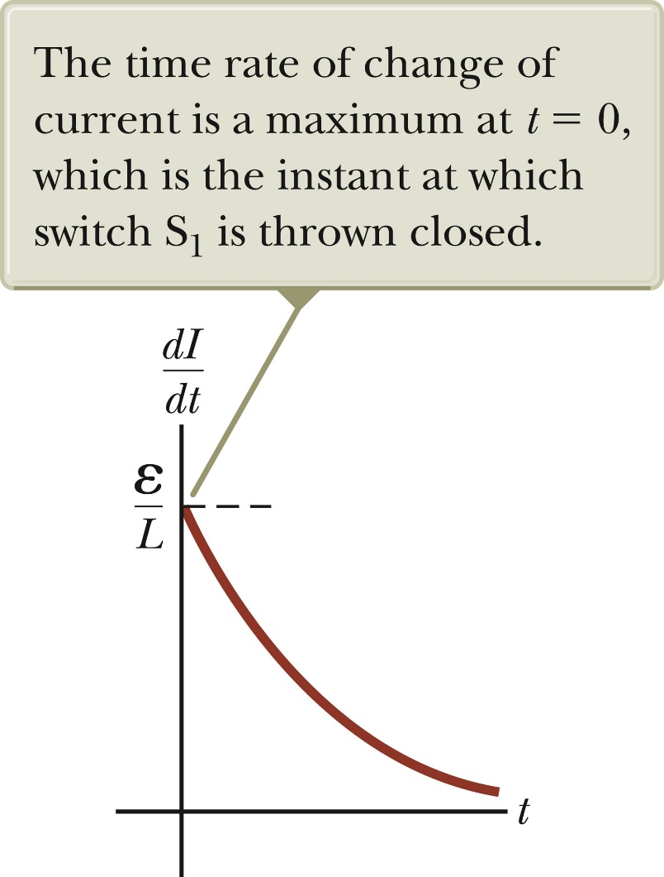

RL Circuit, Current-Time Graph
The time rate of change of the current is a maximum at t = 0.
It falls off exponentially as t approaches infinity.
In general,
Section 32.2

Slide 19

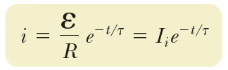
RL Circuit Without A Battery
Now set S₂ to position b
The circuit now contains just the right hand loop .
The battery has been eliminated .
The expression for the current becomes
If the circuit did not contain an inductor, the current would immediately decrease to zero when the battery is removed. When the inductor is present, it opposes the decrease in the current and causes the current to decrease exponentially.
Section 32.2

Slide 20

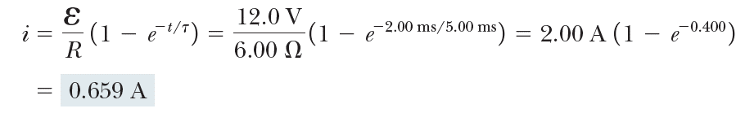
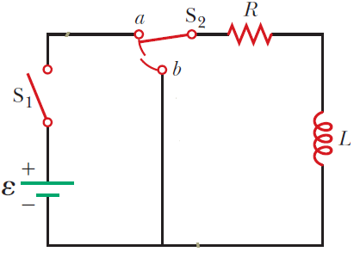
Time Constant of an RL Circuit, Example
Section 32.2

Slide 21
Energy in a Magnetic Field
In a circuit with an inductor, the battery must supply more energy than in a circuit without an inductor.
Part of the energy supplied by the battery appears as internal energy in the resistor.
The remaining energy is stored in the magnetic field of the inductor.
Section 32.3

Slide 22
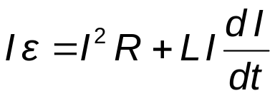
Energy in a Magnetic Field, cont.
Looking at this energy (in terms of rate)
  Iε is the rate at which energy is being supplied by the battery.
  I²R is the rate at which the energy is being delivered to the resistor.
  Therefore, LI (dI/dt) must be the rate at which the energy is being stored in the magnetic field.
Section 32.3

Slide 23
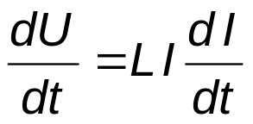
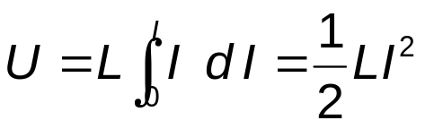
Energy in a Magnetic Field, final
Let U denote the energy stored in the inductor at any time.
The rate at which the energy is stored is
To find the total energy, integrate and
Section 32.3

Slide 24
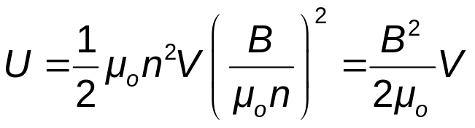
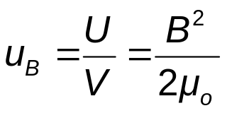
Energy Density of a Magnetic Field
Given U = ½ L I² and assume (for simplicity) a solenoid with L = μ_{o} n² V
Since V is the volume of the solenoid, the magnetic energy density, u_{B} is
This applies to any region in which a magnetic field exists (not just the solenoid).
Section 32.3

Slide 25
Energy Storage Summary
A resistor, inductor and capacitor all store energy through different mechanisms.
  Charged capacitor
    Stores energy as electric potential energy
  Inductor
    When it carries a current, stores energy as magnetic potential energy
  Resistor
    Energy delivered is transformed into internal energy
Section 32.3

Slide 26
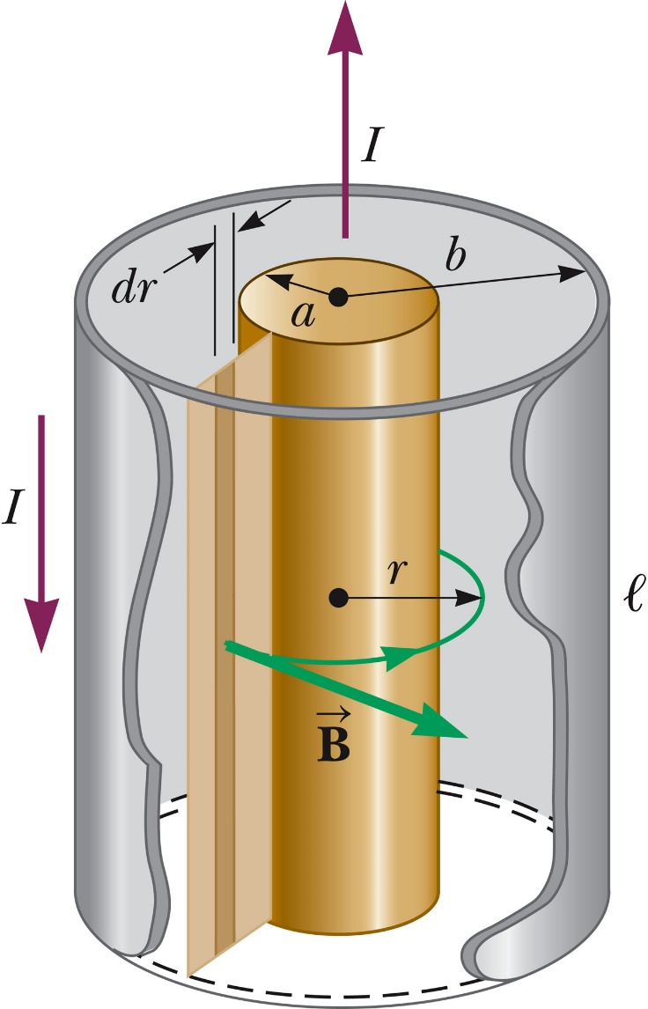
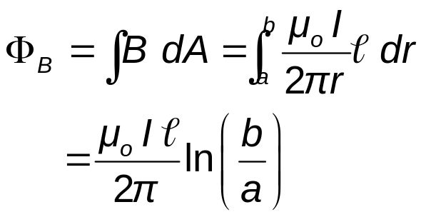
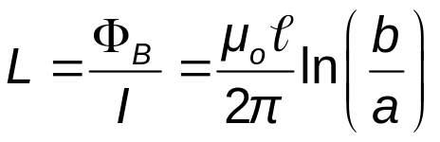
Example: The Coaxial Cable
Calculate L of a length ℓ for the cable
The total flux is
Therefore, L is
Section 32.3

Slide 27
Mutual Inductance
The magnetic flux through the area enclosed by a circuit often varies with time because of time-varying currents in nearby circuits.
This process is known as mutual induction because it depends on the interaction of two circuits.
Section 32.4

Slide 28
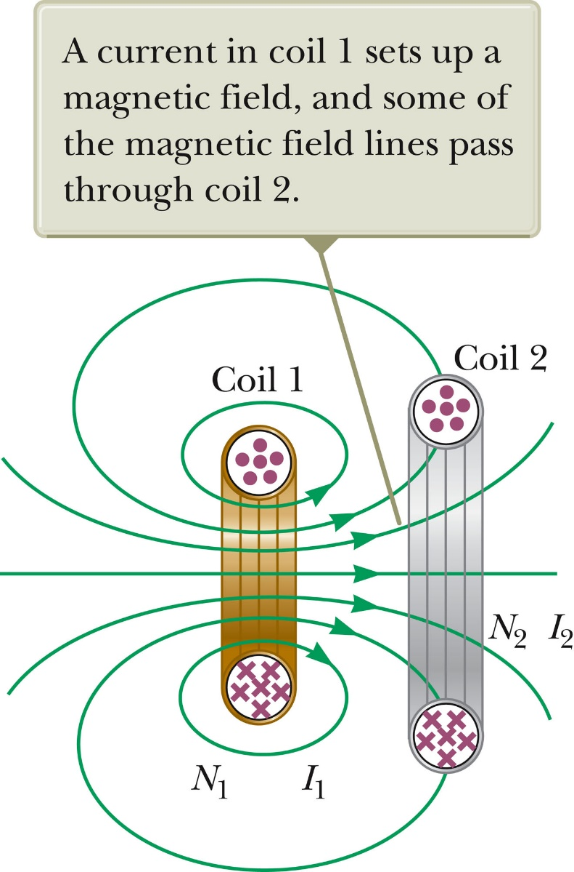
Mutual Inductance, cont.
The current in coil 1 sets up a magnetic field.
Some of the magnetic field lines pass through coil 2.
Coil 1 has a current I₁ and N₁ turns.
Coil 2 has N₂ turns.
Section 32.4

Slide 29

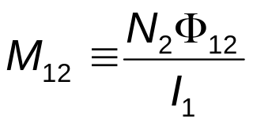
Mutual Inductance, final
The magnetic flux caused by the current in coil 1 and passing through coil 2 is represented .
The mutual inductance M₁₂ of coil 2 with respect to coil 1 is
Mutual inductance depends on the geometry of both circuits and on their orientation with respect to each other.
As the circuit separation distance increases, the mutual inductance decreases because the flux linking the circuits decreases.
Section 32.4

Slide 30


Induced emf in Mutual Inductance
If current i₁ varies with time, the emf induced by coil 1 in coil 2 is
If the current is in coil 2, there is a mutual inductance M_{21.}
If current 2 varies with time, the emf induced by coil 2 in coil 1 is
Section 32.4

Slide 31

Induced emf in Mutual Inductance, cont.
In mutual induction, the emf induced in one coil is always proportional to the rate at which the current in the other coil is changing.
The mutual inductance in one coil is equal to the mutual inductance in the other coil.
  M₁₂ = M₂₁ = M
The induced emf’s can be expressed as
Section 32.4

Slide 32
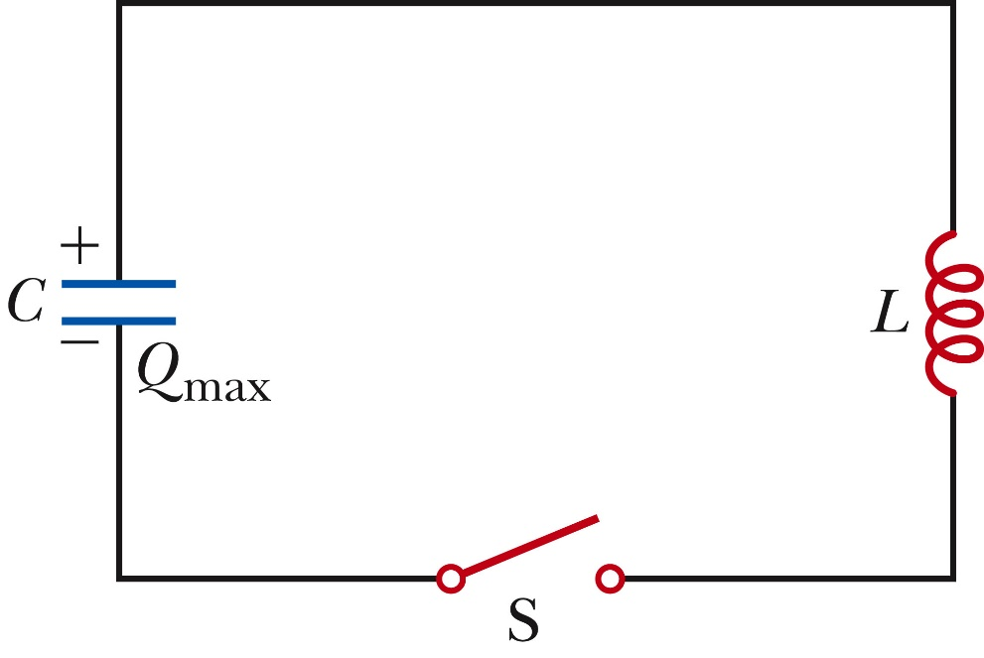
LC Circuits
A capacitor is connected to an inductor in an LC circuit.
Assume the capacitor is initially charged and then the switch is closed.
Assume no resistance and no energy losses to radiation.
Section 32.5
Notes:
We also assume an idealized situation in
which energy is not radiated away from the circuit. This radiation mechanism is
discussed in Chapter 34.

Slide 33
Oscillations in an LC Circuit
Under the previous conditions, the current in the circuit and the charge on the capacitor oscillate between maximum positive and negative values.
With zero resistance, no energy is transformed into internal energy.
Ideally, the oscillations in the circuit persist indefinitely.
  The idealizations are no resistance and no radiation.
The capacitor is fully charged.
  The energy U in the circuit is stored in the electric field of the capacitor.
  The energy is equal to Q²_{max} / 2C.
  The current in the circuit is zero.
  No energy is stored in the inductor.
The switch is closed.
Section 32.5

Slide 34
Oscillations in an LC Circuit, cont.
The current is equal to the rate at which the charge changes on the capacitor.
  As the capacitor discharges, the energy stored in the electric field decreases.
  Since there is now a current, some energy is stored in the magnetic field of the inductor.
  Energy is transferred from the electric field to the magnetic field.
Eventually, the capacitor becomes fully discharged.
  It stores no energy.
  All of the energy is stored in the magnetic field of the inductor.
  The current reaches its maximum value.
The current now decreases in magnitude, recharging the capacitor with its plates having opposite their initial polarity.
Section 32.5

Slide 35

Oscillations in an LC Circuit, final
The capacitor becomes fully charged and the cycle repeats.
The energy continues to oscillate between the inductor and the capacitor.
The total energy stored in the LC circuit remains constant in time and equals.
Section 32.5

Slide 36
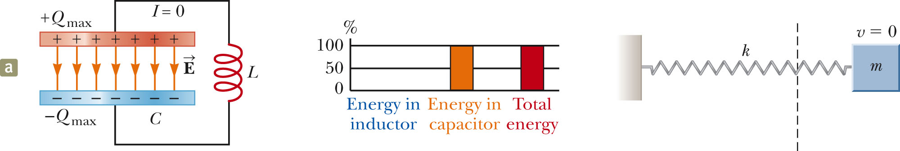
LC Circuit Analogy to Spring-Mass System, 1
The potential energy ½kx² stored in the spring is analogous to the electric potential energy (Q_{max})²/(2C) stored in the capacitor.
All the energy is stored in the capacitor at t = 0.
This is analogous to the spring stretched to its amplitude.
Section 32.5

Slide 37
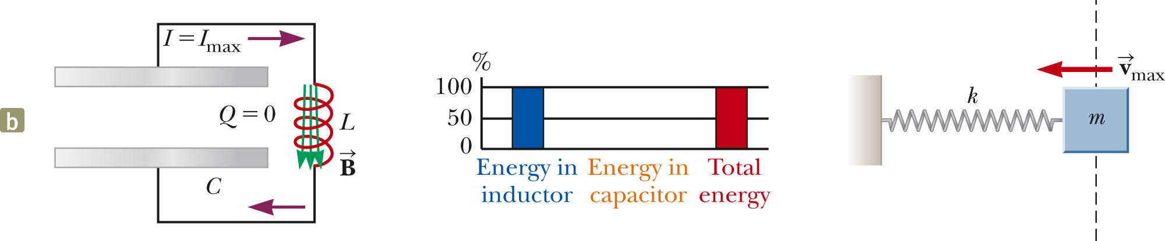
LC Circuit Analogy to Spring-Mass System, 2
The kinetic energy (½ mv²) of the spring is analogous to the magnetic energy (½ L I²) stored in the inductor.
At t = ¼ T, all the energy is stored as magnetic energy in the inductor.
The maximum current occurs in the circuit.
This is analogous to the mass at equilibrium.
Section 32.5

Slide 38
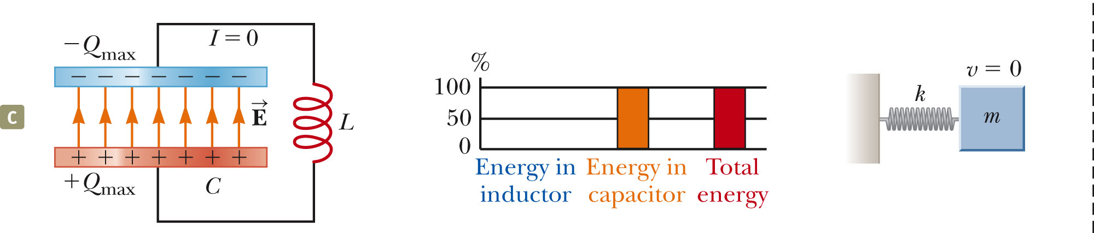
LC Circuit Analogy to Spring-Mass System, 3
At t = ½ T, the energy in the circuit is completely stored in the capacitor.
The polarity of the capacitor is reversed.
This is analogous to the spring stretched to -A.
Section 32.5

Slide 39
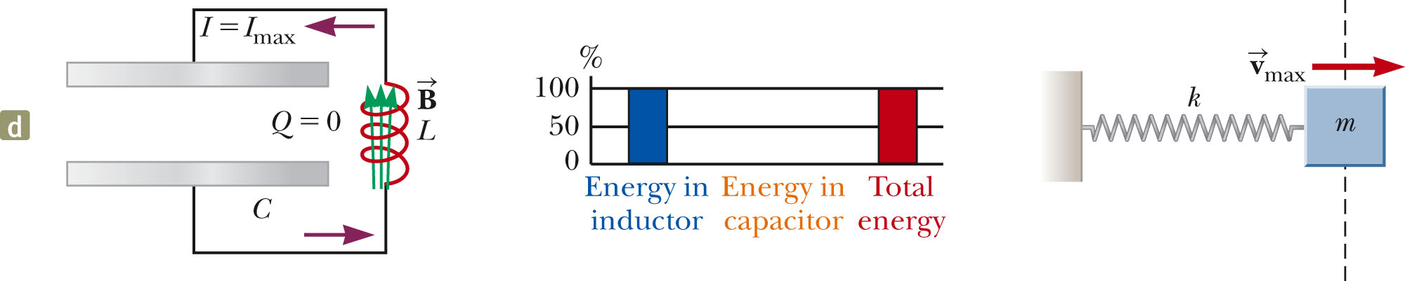
LC Circuit Analogy to Spring-Mass System, 4
At t = ¾ T, the energy is again stored in the magnetic field of the inductor.
This is analogous to the mass again reaching the equilibrium position.
Section 32.5

Slide 40
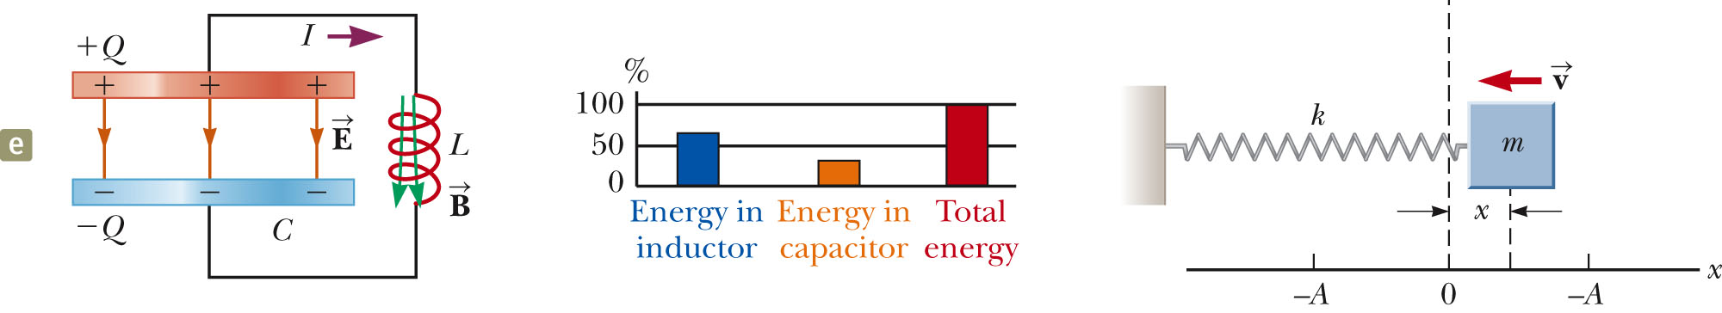
LC Circuit Analogy to Spring-Mass System, 5
At t = T, the cycle is completed
The conditions return to those identical to the initial conditions.
At other points in the cycle, energy is shared between the electric and magnetic fields.
Section 32.5

Slide 41
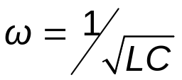
Time Functions of an LC Circuit
In an LC circuit, charge can be expressed as a function of time.
  Q = Q_{max} cos (ωt + φ)
  This is for an ideal LC circuit
The angular frequency, ω, of the circuit depends on the inductance and the capacitance.
  It is the natural frequency of oscillation of the circuit.
Section 32.5

Slide 42


Time Functions of an LC Circuit, cont.
The current can be expressed as a function of time:
The total energy can be expressed as a function of time:
Section 32.5

Slide 43
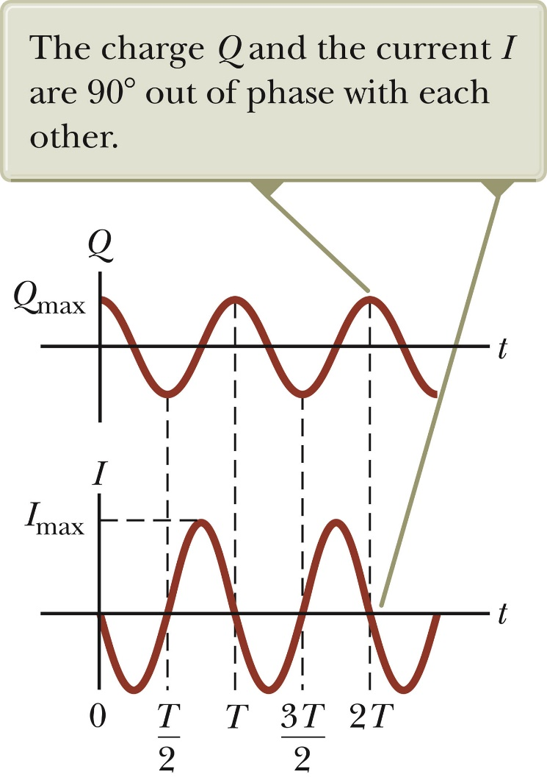
Charge and Current in an LC Circuit
The charge on the capacitor oscillates between Q_{max} and -Q_{max.}
The current in the inductor oscillates between I_{max} and -I_{max.}
Q and I are 90º out of phase with each other
  So when Q is a maximum, I is zero, etc.
Section 32.5

Slide 44
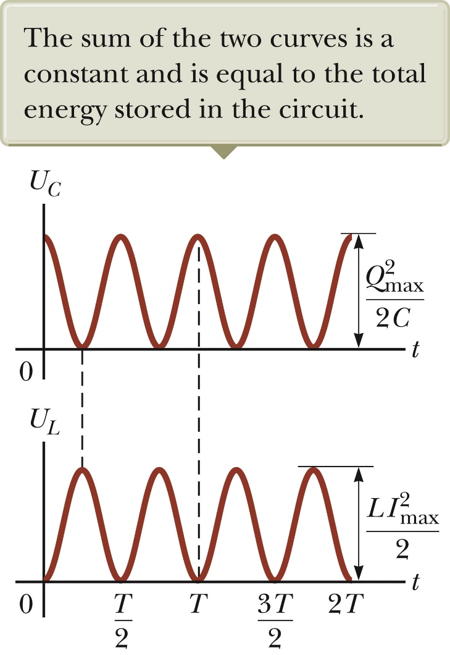
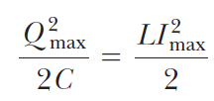
Energy in an LC Circuit – Graphs
The energy continually oscillates between the energy stored in the electric and magnetic fields.
When the total energy is stored in one field, the energy stored in the other field is zero.
The amplitudes of the two graphs in must be equal because the maximum energy stored in the capacitor (when I = 0) must equal the maximum energy stored in the inductor (when q = 0).
Section 32.5

Slide 45
Notes About Real LC Circuits
In actual circuits, there is always some resistance.
Therefore, there is some energy transformed to internal energy.
Radiation is also inevitable in this type of circuit.
The total energy in the circuit continuously decreases as a result of these processes.
Section 32.5

Slide 46
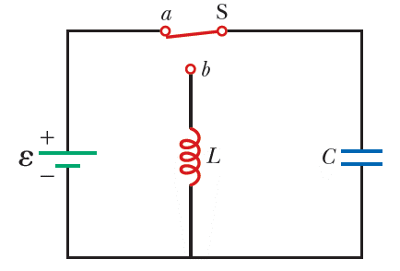
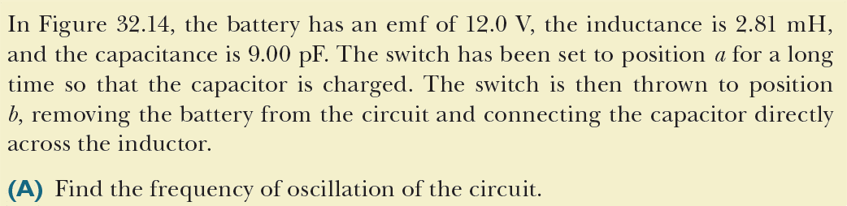
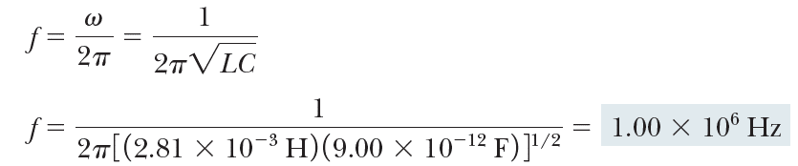
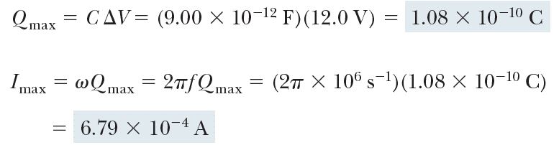
Oscillations in an LC Circuit, example
Section 32.5

Slide 47
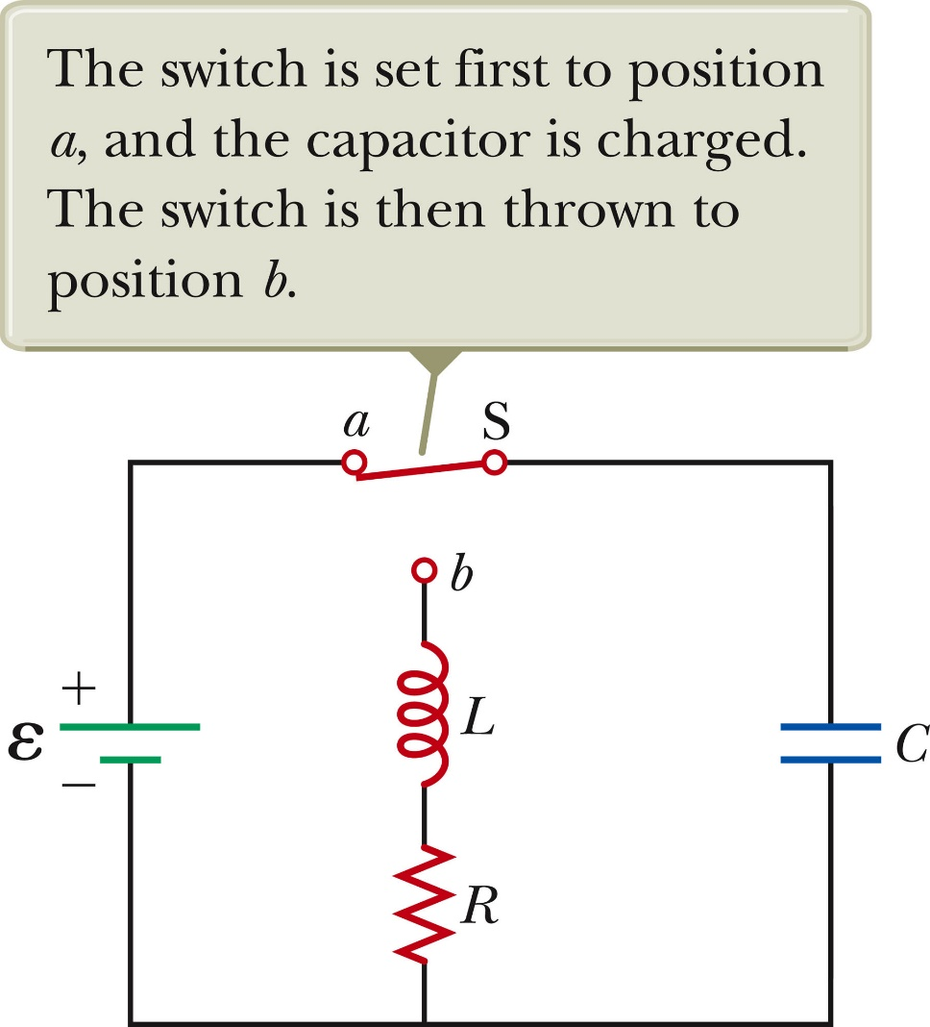
The RLC Circuit
A circuit containing a resistor, an inductor and a capacitor is called an RLC Circuit.
Assume the resistor represents the total resistance of the circuit.
Section 32.6

Slide 48

RLC Circuit, Analysis
The total energy is not constant, since there is a transformation to internal energy in the resistor at the rate of dU/dt = -I²R.
  Radiation losses are still ignored
The circuit’s operation can be expressed as
Section 32.6
Notes:
the negative sign signifies that the energy U of the circuit is decreasing in
time.

Slide 49
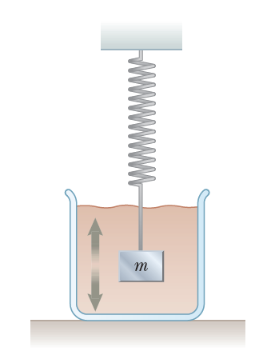


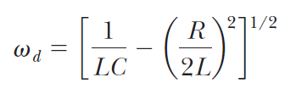


RLC Circuit Compared to Damped Oscillators
The RLC circuit is analogous to a damped harmonic oscillator.
When R = 0
  The circuit reduces to an LC circuit and is equivalent to no damping in a mechanical oscillator.
When R is small:
  The RLC circuit is analogous to light damping in a mechanical oscillator.
  ω_{d} is the angular frequency of oscillation for the circuit and
When (so that the second term in the brackets is much smaller than the first), the frequency of the damped oscillator is close to that of the undamped oscillator,
Section 32.6
Notes:
we see that q corresponds to the position x of the block at any instant, L to the mass m of the block, R to the damping coefficient b, and C to 1/k, where k is the force constant of the spring. These and other
relationships are listed in Table 32.1 on page 986.

Slide 50

RLC Circuit Compared to Damped Oscillators, cont.
When R is very large, the oscillations damp out very rapidly.
There is a critical value of R above which no oscillations occur.
If R = R_{C}, the circuit is said to be critically damped.
When R > R_{C}, the circuit is said to be overdamped.
Section 32.6

Slide 51
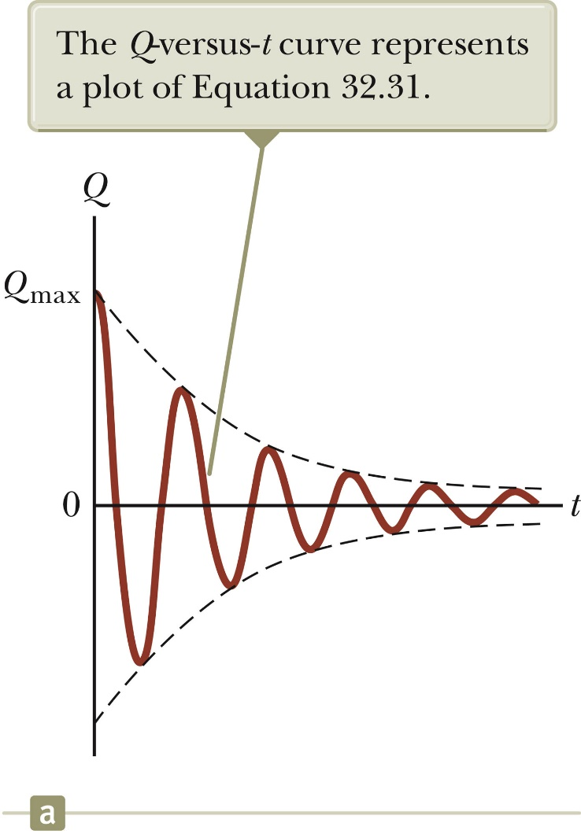

Damped RLC Circuit, Graph
The maximum value of Q decreases after each oscillation.
  R < R_{C}
This is analogous to the amplitude of a damped spring-mass system.
Section 32.6

Slide 52
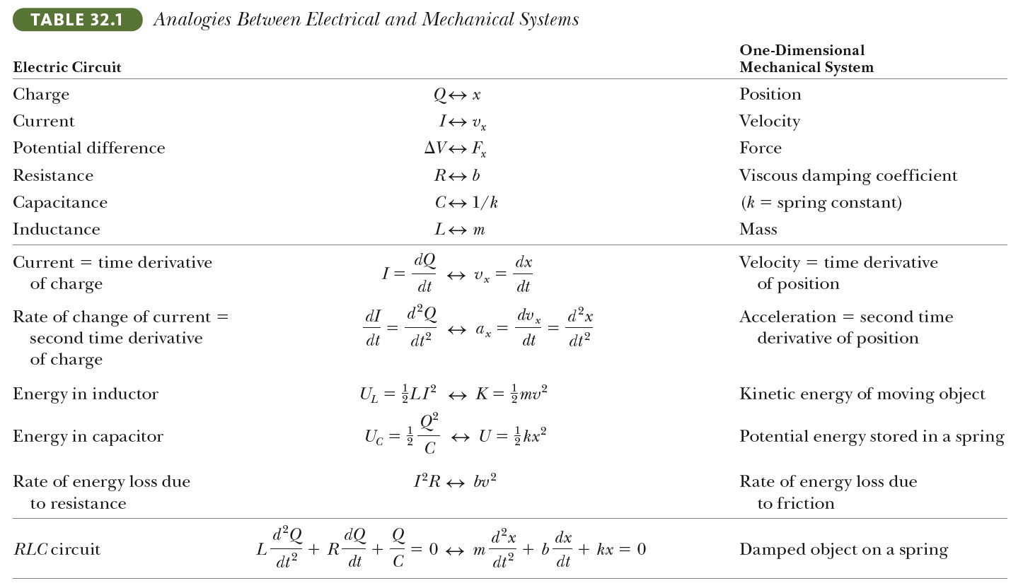
Summary: Analogies Between Electrical and Mechanic Systems
Section 32.6

